Slide 1

Biomedical Image Processing – Non-Rigid Transformations & Animations
Paul Vu 301169550 March 31st 2017

Slide 2
Project Overview
We try to understand non-rigid transformation of images by transforming a non-smiling selfie into a smiling one and vice versa. We also plot the vector field of the displacement u(x).
In the second part of the project, we attempt to distort the selfies in an unnatural way, this is done by mapping the exaggerated smile selfie to unusual parts on the original image such as the nose and eyes.
Finally, in the last part of the project we create animated gifs by performing non-rigid transforms with different frame samples and step sizes, saving the results in a gif.

Slide 3
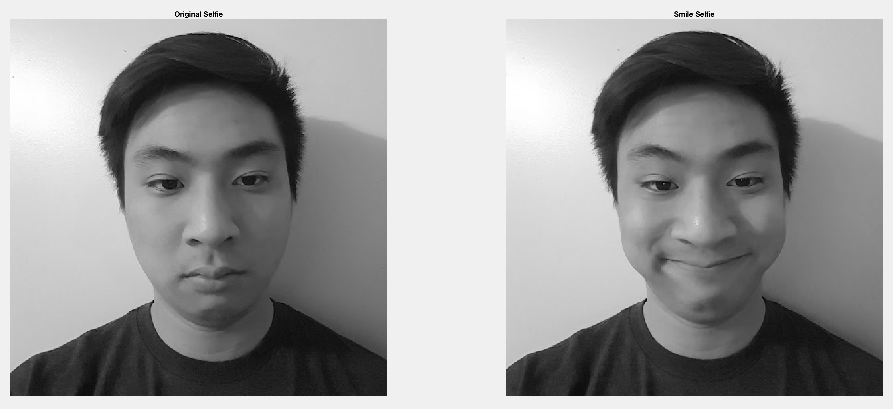
Project Overview
We first take two images, a template selfie and a second smiling selfie. The images are converted to grey scale and are of the same 567x567 dimension size. With these images we investigate non-rigid transformations in MATLAB.
Fig. 1 Original and smiling selfie images used in Animation program

Slide 4
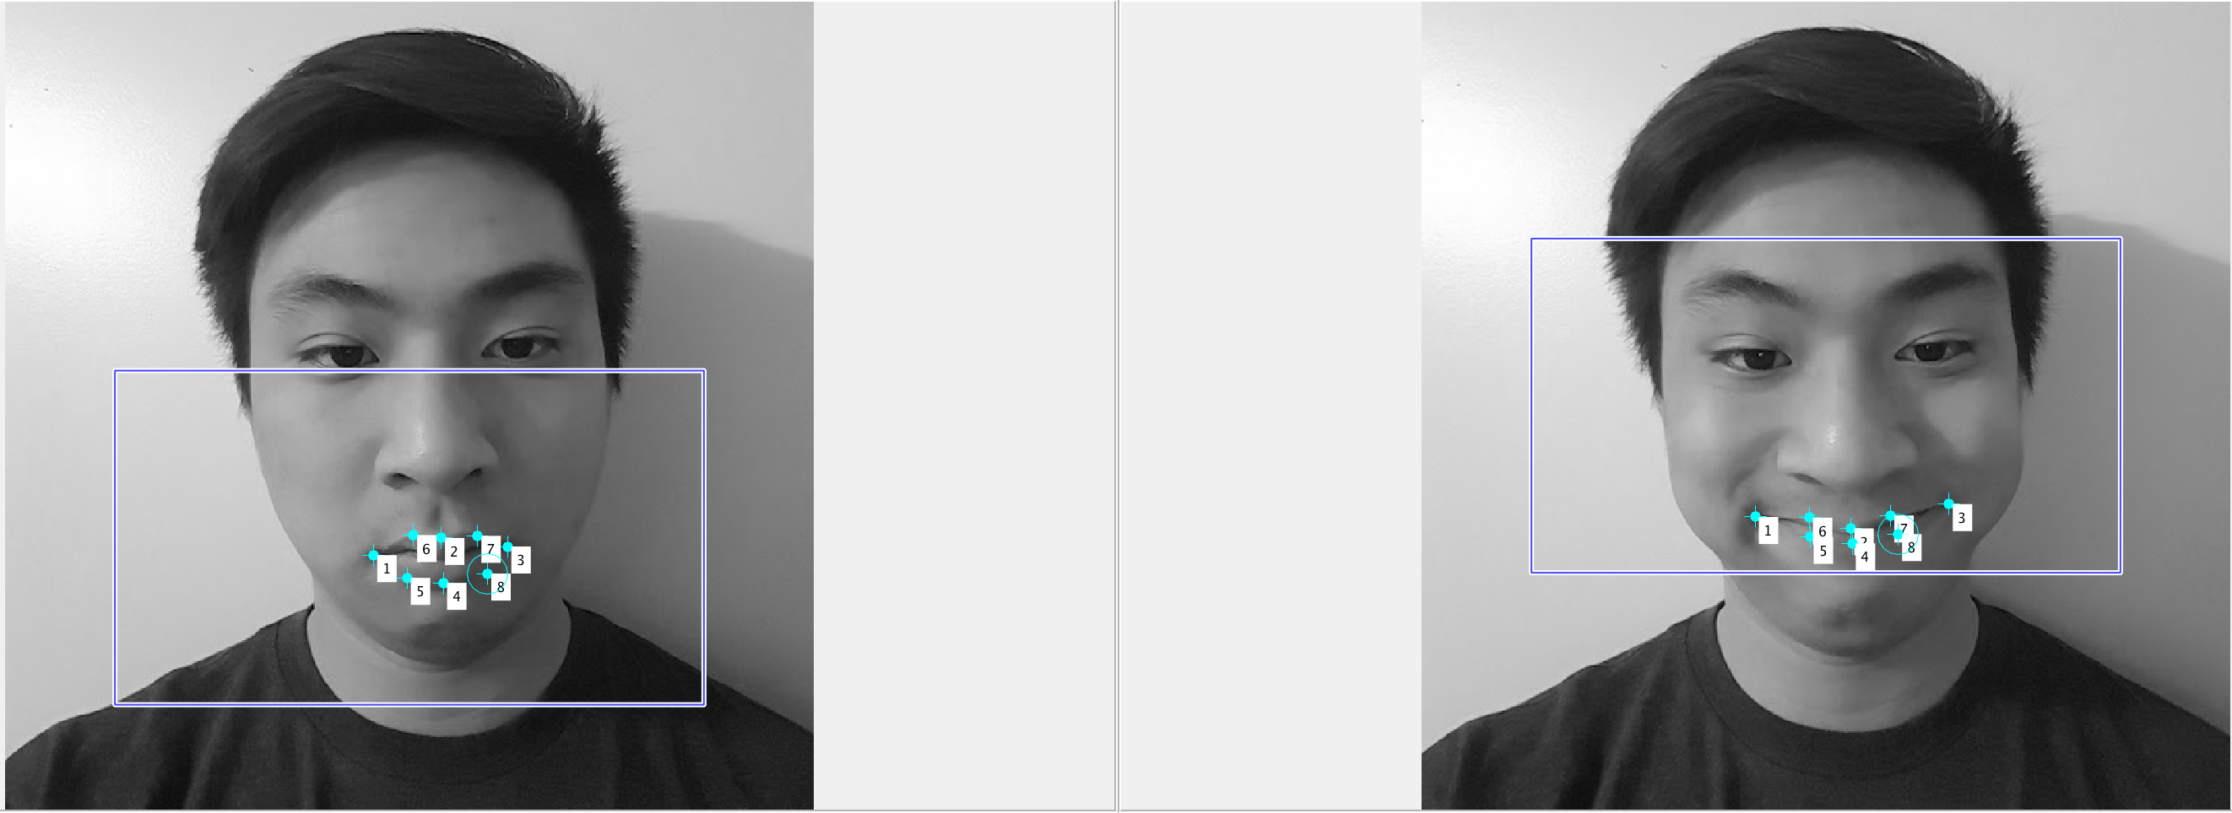
Non-Rigid Transformation
For the first part of the project, I take my smiling selfie (target image) and my straight faced selfie (template image) and place landmarks corresponding to my lips. This is shown in Fig. 2 below.
Fig. 2 Straight faced selfie and smiling selfie with corresponding landmarks

Slide 5
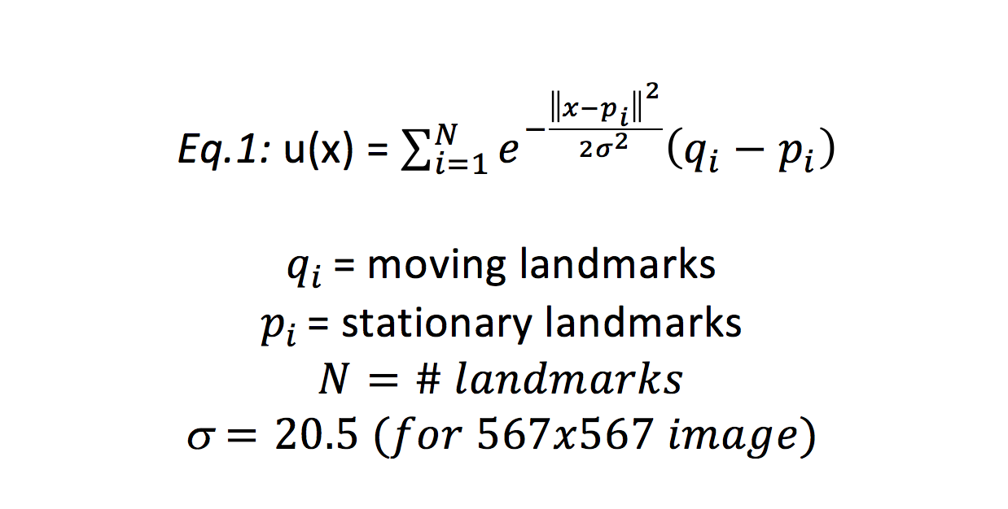
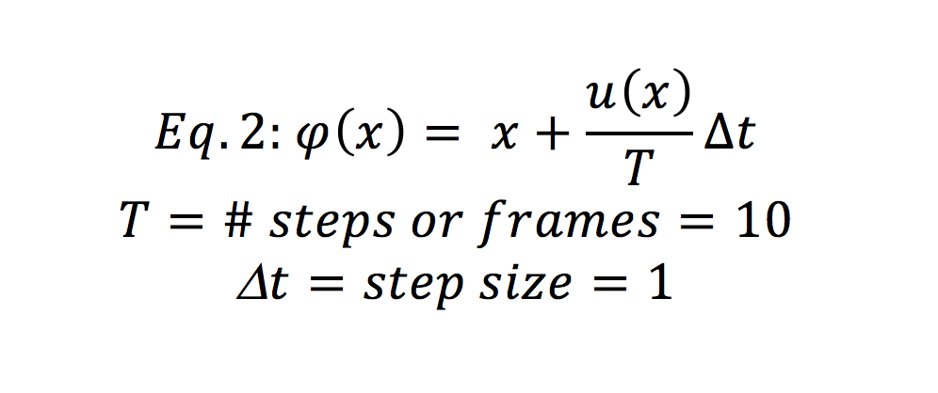
Non-Rigid Transformation: Theory
The approach of the non-rigid transformation algorithm is to take every pixel and compare it’s displacement to all the recorded landmarks. If it’s a large displacement the displacement factor will be minimal and the pixel will not be interpolated. If the displacement is small, u(x) will have a large value and bilinear interpolation will be required to find the corresponding image. Each displacement can be taken over T – frames, when T > 1 we can create an animation from the resulting frame set.
Eq.1 The displacement function
Eq.2 The non-rigid Transform

Slide 6
Non-Rigid Transformation: Theory
For part 1 & 2 we have T = 1 as we are only interested in the non-rigid transformation’s output, however in part 3 we set T = 10 meaning we sample the displacement over 10 steps with step size = 1. As a result we can take these results to view an animation of the non-rigid transformation.
Eq.1 The displacement function
Eq.2 The non-rigid Transform

Slide 7
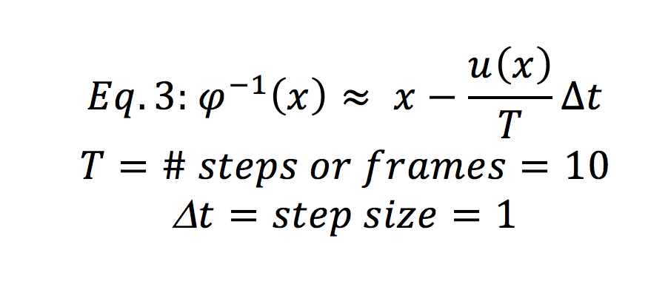
Inverse Non-Rigid Transformation: Theory
To take the inverse transform we simply subtract the displacement u(x) from the pixel’s coordinate.
Eq.3 The non-rigid Transform

Slide 8
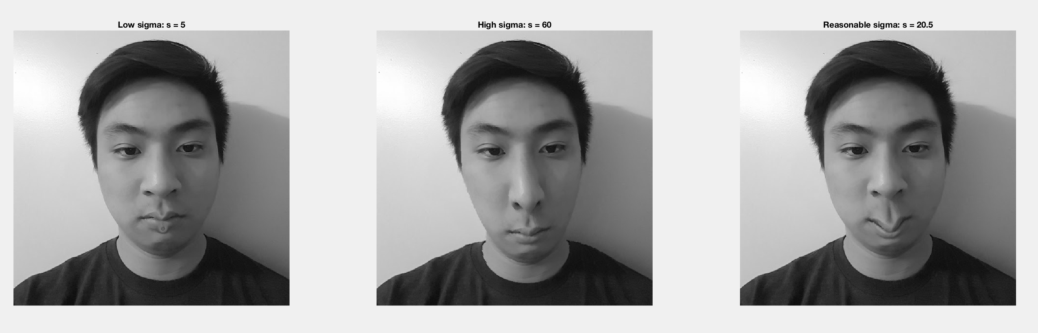
Non-Rigid Transformation: Design Choice
Given my 567x 567 image choosing a standard deviation that was too low ex: 5, would only create a local movement of pixels, while choosing a large standard deviation ex: 60 would distort the image since a lot of pixels far away from the desired moving landmarks will experience movement. After experimentation a reasonable standard deviation was found to be 20.5. Results are shown below where we can see a low sigma doesn’t transform enough pixels, while a large sigma transforms my lips and nose.
Fig. 3 Non-Rigid Transformation with varying Sigma.

Slide 9
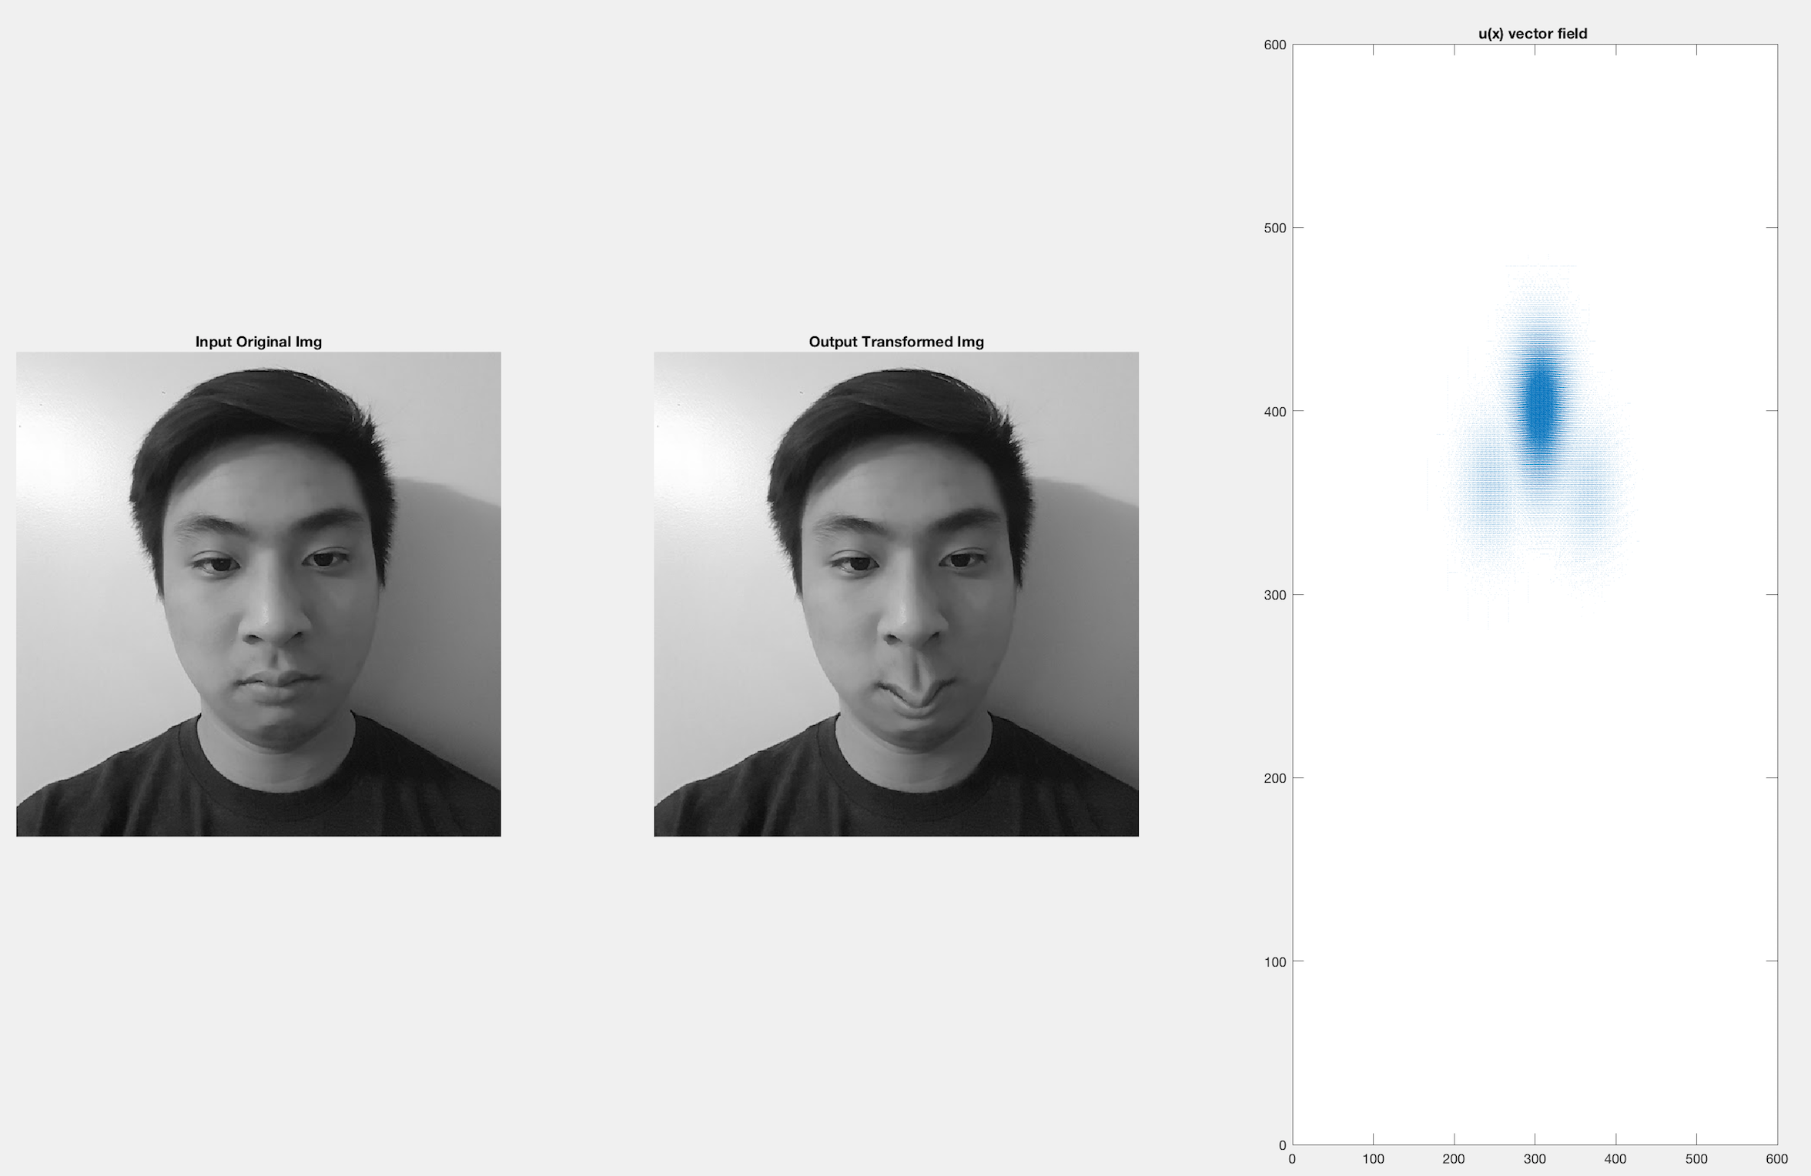
Non-Rigid Transformation: Result
The results of the non-rigid transform with sigma = 20.5 is shown in Fig 4. We can see that from the plotted vector field, the directions of the vectors are moving such that the side of my lips are pushed upwards while the middle of my lips are pushed downwards. This is consistent with the results shown in the depicted output image.
Fig. 4 Non-Rigid Transformation Output & Vector field plot of u(x) using MATLAB’s quiver function

Slide 10
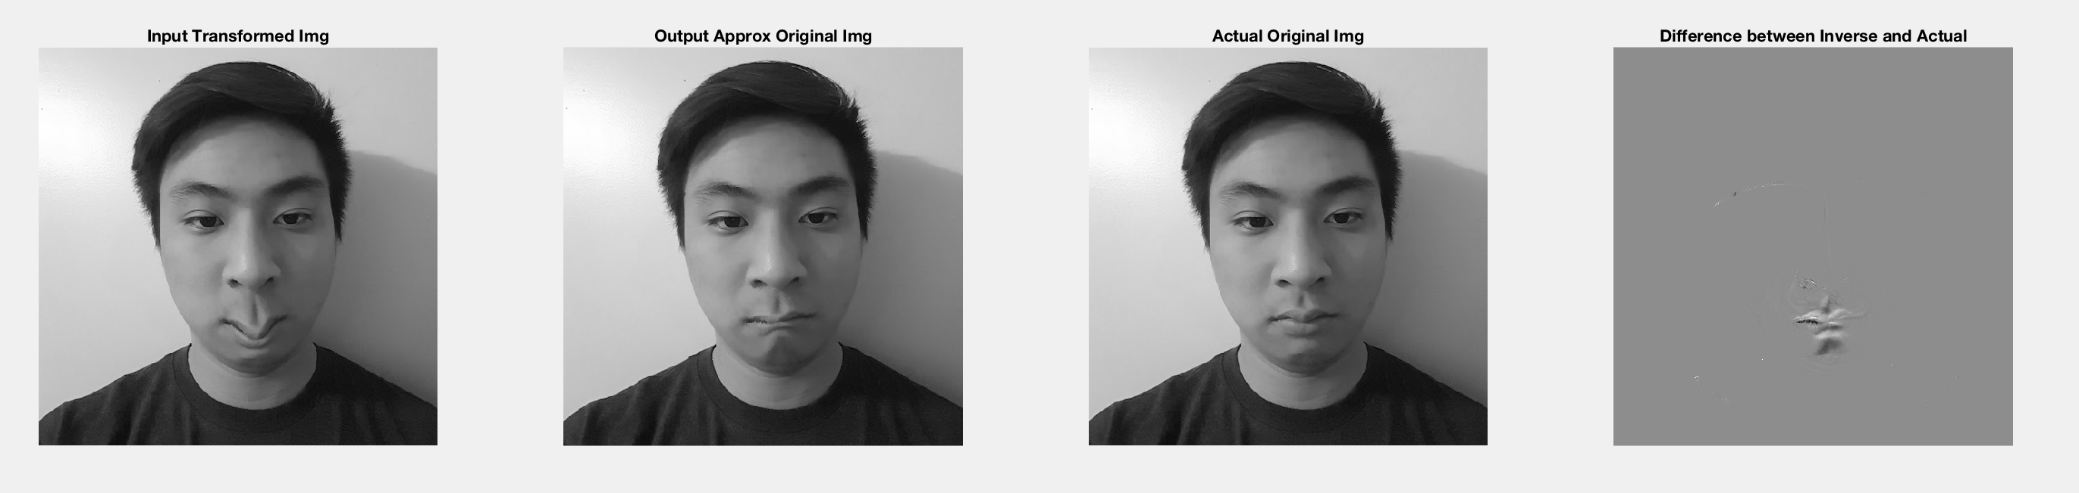
Non-Rigid Transformation: Result
Using the Transformed Image from the previous example as an input, we now perform the inverse non-rigid transform which is an identical function to the forward non-rigid transform except instead of adding the displacement u(x) we now subtract. We can see the resulting output image is very similar to the original image with slight error in the lip area. This is further exemplified by plotting the difference between the approximate inverse image with the original image as shown in figure 5
Fig. 5 Inverse Non-Rigid Transformation

Slide 11
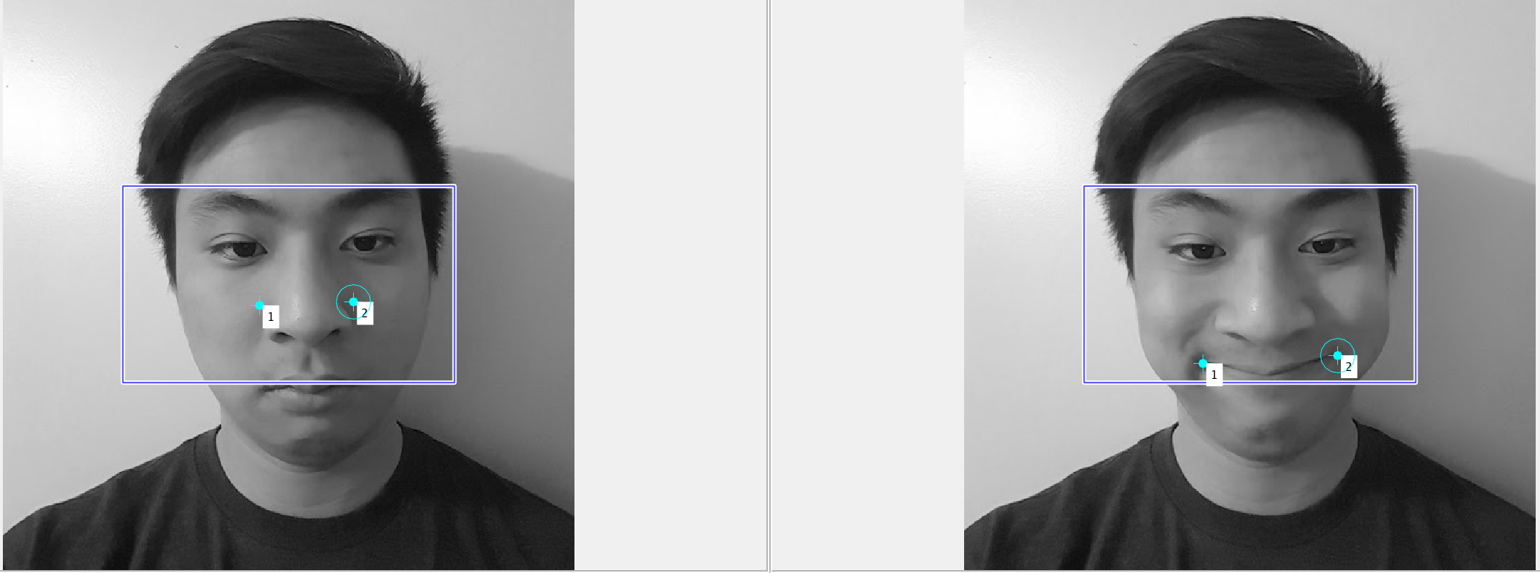
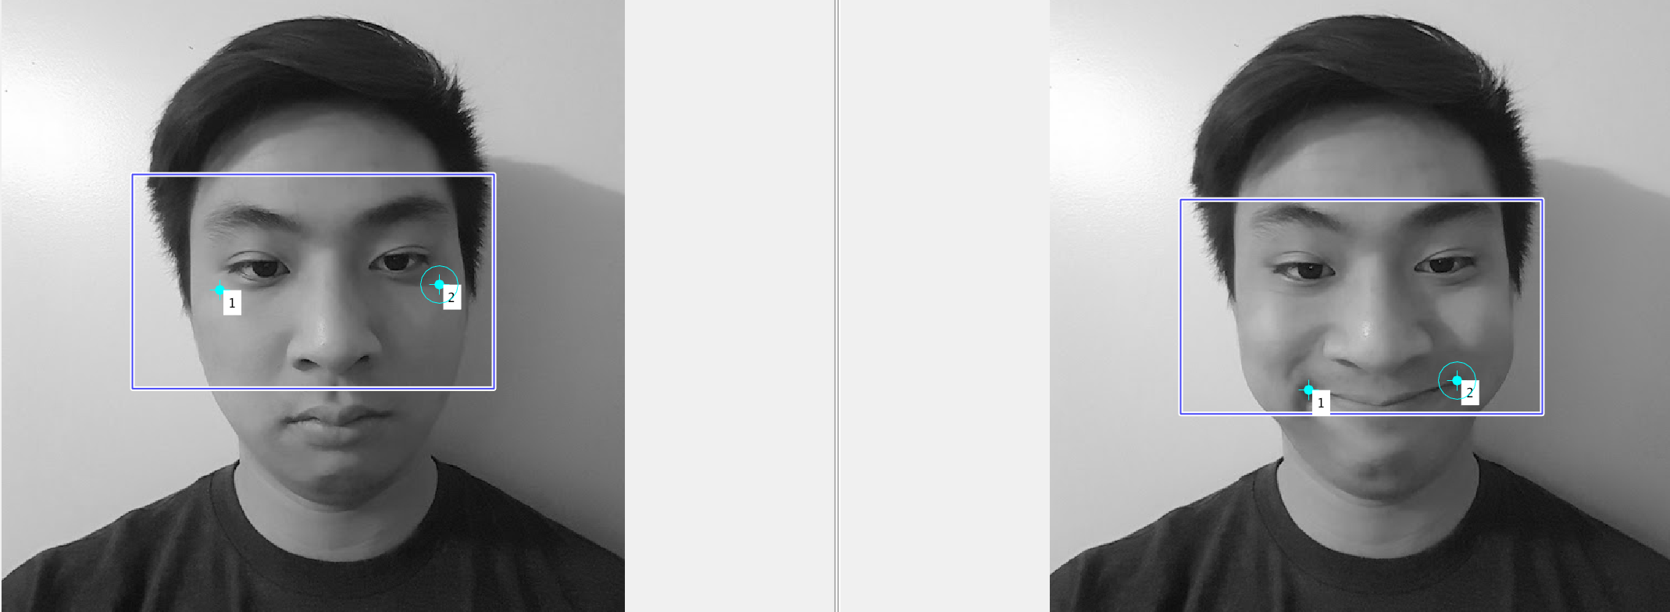
Non-Rigid: Unnatural Landmarks
In choosing landmarks I will try to exaggerate my nose and eyes in an unnatural way. I do this by taking landmarks on the extreme ends of my smile and match it with the extreme ends of my nose and again to the side of my eyes. The philosophy here is that in mapping my smile to my nose/eyes, my non-rigid transform will transform my nose upward similar to a smile. This is shown in Fig. 4.
Fig.6 Unnatural Selfie using incorrect landmarks

Slide 12

Non-Rigid: Unnatural Selfie #1
As a result of my chosen landmarks, my nose is pinched in an unnatural way where my nostrils are curved up. Clearly, by mapping my smile landmark to my nose distorts the image as it tries to map my nose to curve in the shape of my smile. The results are shown in the below figure.
Fig.7 Unnatural Nose Selfie using a Non-Rigid Transformation

Slide 13
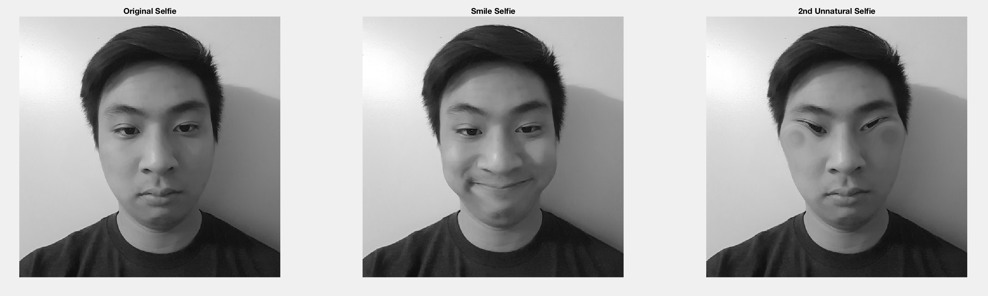
Non-Rigid: Unnatural Selfie #2
As a result of my chosen landmarks, my eyes are curled up in a squinting image. Clearly, by mapping my smile landmark to my eyes distorts the image as it tries to map my eyes to curve in the shape of my smile. The results are shown in the below figure.
Fig.8 Unnatural Eyes Selfie using a Non-Rigid Transformation

Slide 14
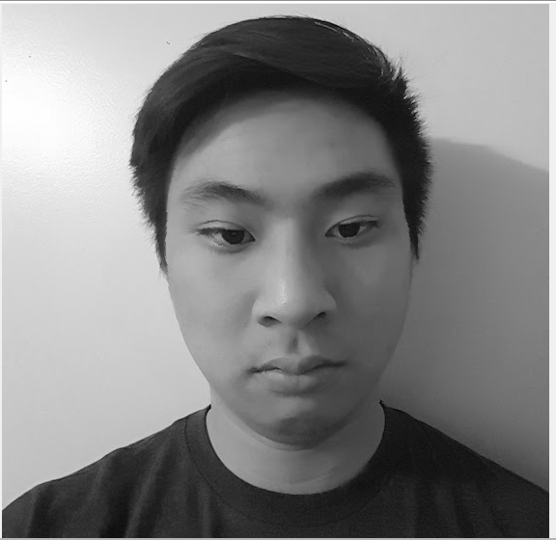
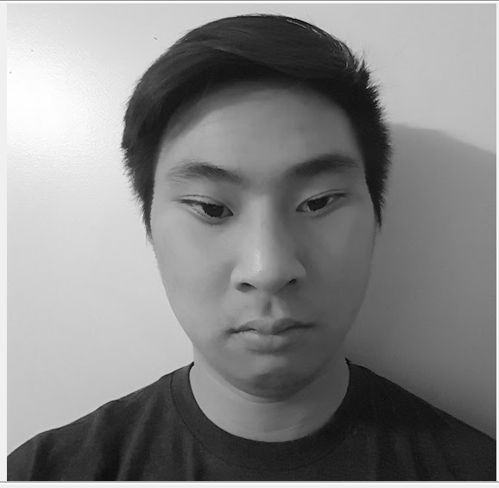
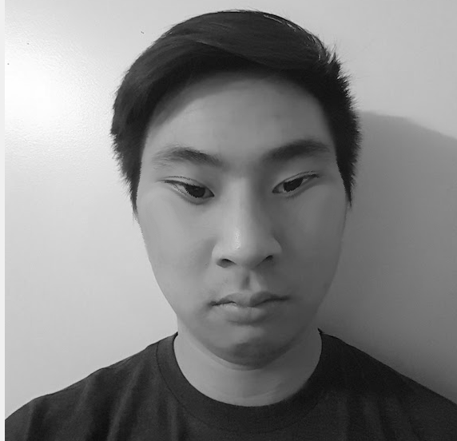
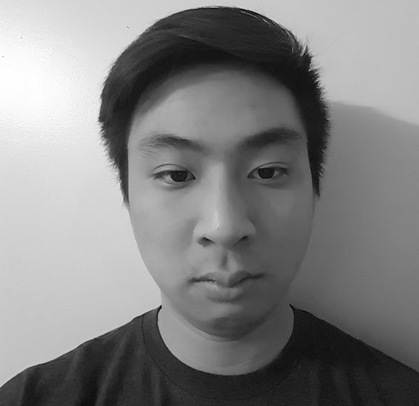
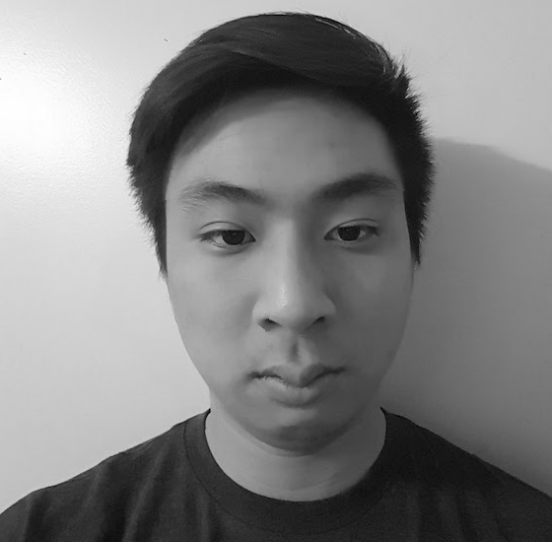
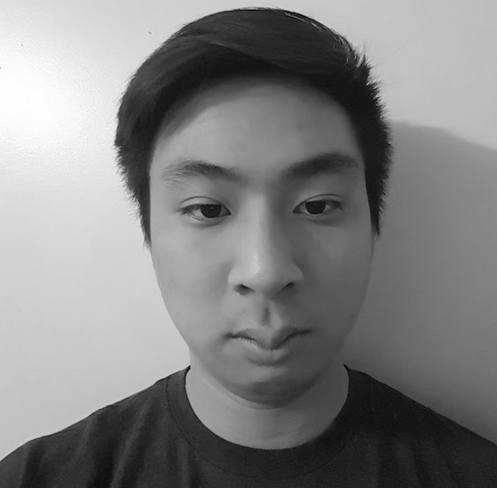

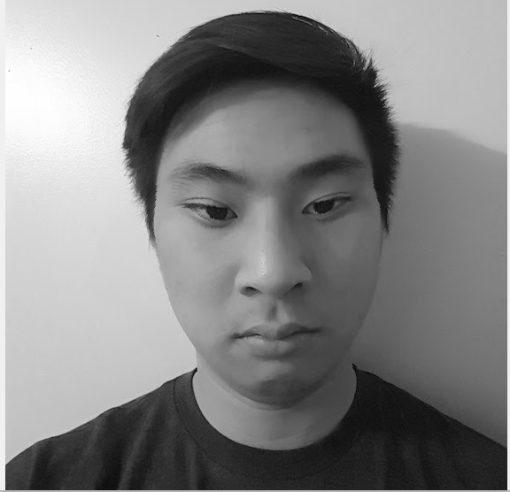


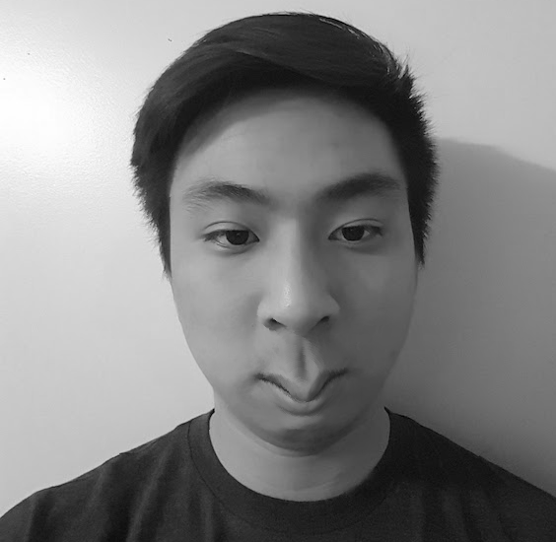

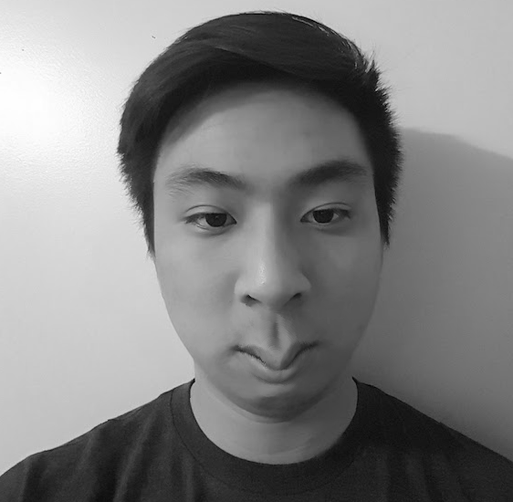






Animations 1: Smile Gif
For the first animation, I simply perform a non-rigid transformation on my smile to my standard selfie to induce a smile. I do this over T = 10 frames, with a step size of 1. In addition I keep my standard deviation at 14.5 as before. My results are shown frame by frame below.
Fig.9 Smile Animation Gif

Slide 15
Animations 2: Squinting Eyes Gif
For the second animation, I perform a non-rigid transformation on my smile to my standard selfie to induce an eye squint. I do this over T = 10 frames, with a step size of 1. However, this time my standard deviation was set to 20.5 to see unique results. As we can see, with an increased standard deviation we can see dark swirls on frame 10 which is where my transformation is heavily impacting the image.
Fig.10 Squinting Eyes Animation Gif

Slide 16
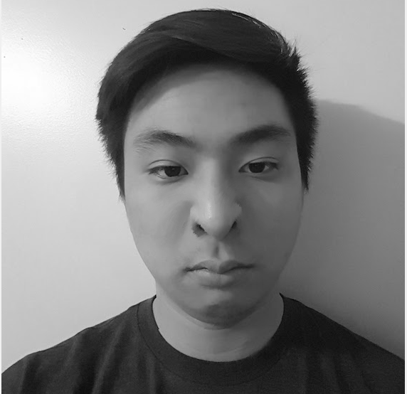









Animations 3: Nose Squint Gif
For the final animation, I perform a non-rigid transformation on my smile to my standard selfie to induce a nose squint. I do this over T = 10 frames, with a step size of 1. Again I keep my standard deviation at 20.5 as before. My results are shown frame by frame below.
Fig.11 Squinting Nose Animation Gif

